Slide 1
Electronic I
Instructor: Dr. Mirhassani (Mir)
Electrical and Computer Engineering
University of Windsor
Winter 2016

Slide 2
555 Timer
The circuit is used for timer, pulse generation, time delay, flip-flop or switch
The original idea was developed in 1971
It is one of the most widely used IC
Two different types of transistors
BJT
MOSFET
Since 2003, 1B units are made every year

Slide 3
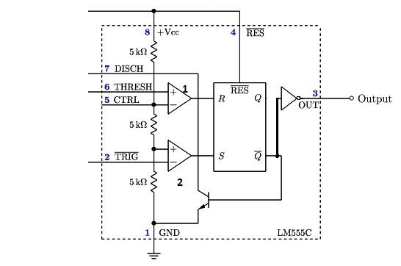
555 Timer
Internally it has
25 transistors
2 diodes
25 resistors
8 pins

Slide 4
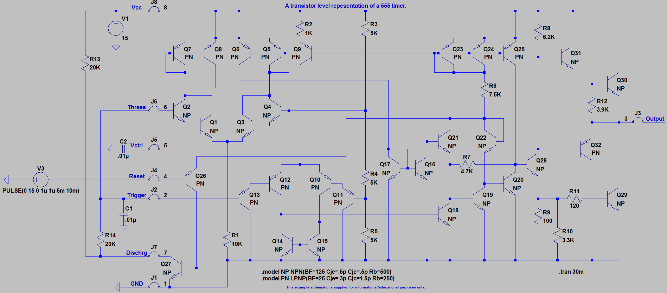
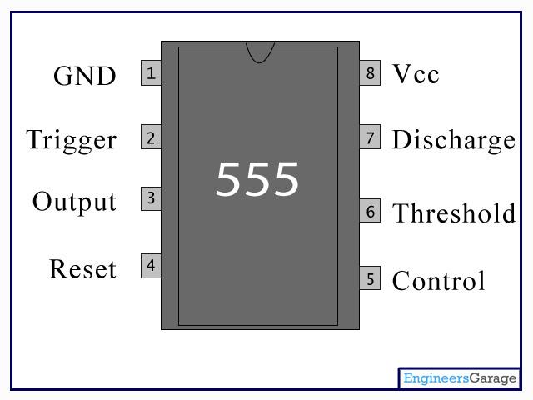
555 Timer

Slide 5
555 Timer

Slide 6
555 Timer - Comparator
A comparator circuit is an opamp circuit that is designed to compare an input with a fixed threshold voltage.
The output will be high if the input voltage is higher than the threshold voltage.
In the 555 IC, if the threshold pin input (pin 6) is higher than 2/3Vcc, the output of CP1 (upper comparator) goes high
When the trigger pin in put is lower than 1/3Vcc, then the output of CP2 (lower comparator) is high

Slide 7
RS Flip-Flop (Control F/F)
When the output of CP2 is high, and thus the output of CP1 is low, then the flip-flop has inputs, R=0 and S=1.
This causes the output of the RS flip-flop to be high, or logic 1.
Thus, the inverted output of the flip-flop will be logic 0, or low.
When the output of CP1 is high, and thus the output of CP2 is low, then the flip-flop has the inputs, R=1 and S=0.
This causes the output of the RS flip-flop to be logic 0 and the inverted output of the flip-flop to be logic 1.

Slide 8
555 Timer - Reset
The last input pin is Cl (pin 4), or reset.
The reset feature of the RS flip-flop is active low.
When the input to the reset pin is low, the flip-flop’s output will be logic 0 and the inverted output will be logic 1.
To disable the reset feature, the input of the flip-flop, and thus the reset pin of the 555 IC, should be tied high.

Slide 9
Pin Operations
Trigger: As we can see that the voltage at the non-inverting end of the comparator is V_{in}/3, so if the trigger input is used to set the output of the F/F to ‘high’ state by applying a voltage equal to or less than V_{in}/3 or any negative pulse, as the voltage at the non-inverting end of the comparator is V_{in}/3.
Output: It is the output pin of the IC, connected to the Q’ (Q-bar) of the F/F with an inverter in between as show in the figure.
Reset: This pin is used to reset the output of the F/F regardless of the initial condition of the F/F and also it is an active low Pin so it connected to ‘high’ state to avoid any noise interference, unless a reset operation is required. So most of the time it is connected to the Supply voltage as shown in the figure.
Control Voltage: As we can see that the pin 5 is connected to the inverting input having a voltage level of (2/3) V_{in}. It is used to override the inverting voltage to change the width of the output signal irrespective of the RC timing network.
Threshold: The pin is connected to the non-inverting input of the first comparator. The output of the comparator will be high when the threshold voltage will be more than (2/3) V_{in} thus resetting the output (Q) of the F/F from ‘high’ to ‘low’.
Discharge: This pin is used to discharge the timing capacitors (capacitors involved in the external circuit to make the IC behave as a square wave generator) to ground when the output of Pin 3 is switched to ‘low’.

Slide 10
Modes of Operation
The 555 timer can be used in three main modes of operations
Astabble
Monostable
Bistable

Slide 11
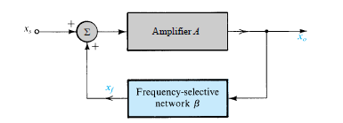
Positive Feedback

Slide 12
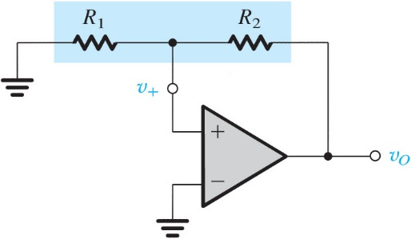
Figure 18.19 A positive-feedback loop capable of bistable operation.

Slide 13
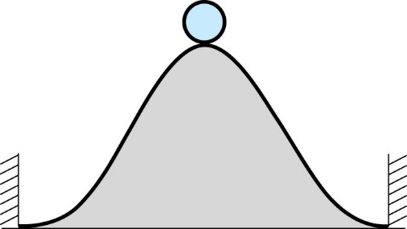
Figure 18.20 A physical analogy for the operation of the bistable circuit. The ball cannot remain at the top of the hill for any length of time (a state of unstable equilibrium or metastability); the inevitably present disturbance will cause the ball to fall to one side or the other, where it can remain indefinitely (the two stable states).

Slide 14
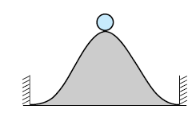
Bistable mode
It can be called Schmitt trigger.
The 555 can operate as a flip-flop, if the pin 7 is not connected and no capacitor is used.
It can be used in bouncefree latched switches.

Slide 15
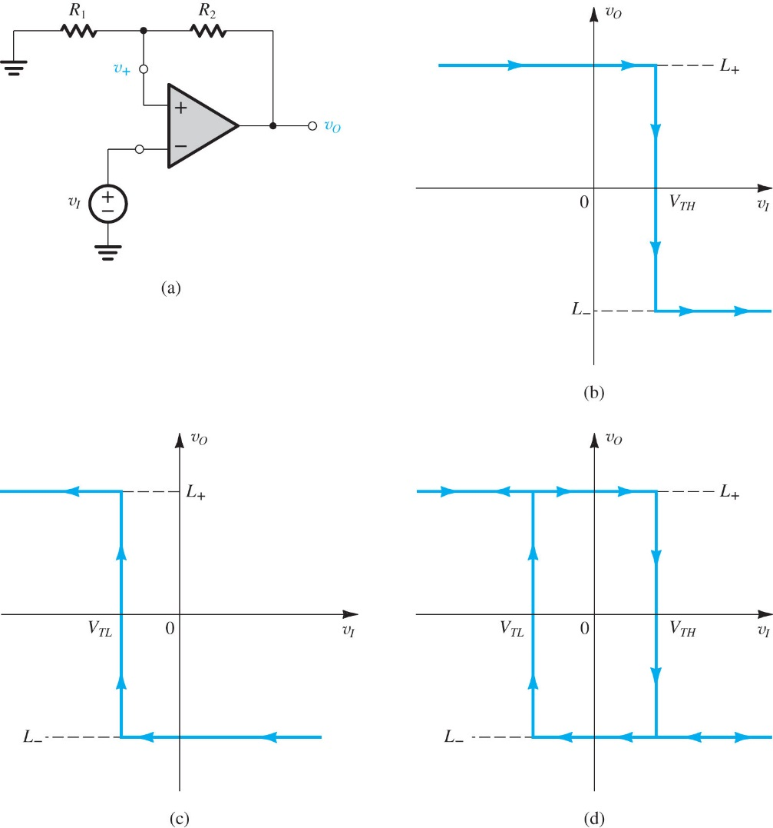

Slide 16
Monostable Operation
In this mode, the 555 functions as a "one-shot".
Applications include timers, missing pulse detection, bouncefree switches, touch switches, frequency divider, capacitance measurement, pulse-width modulation (PWM).

Slide 17
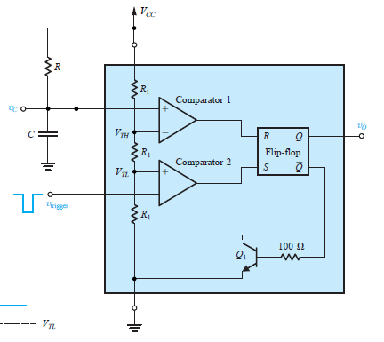
Monostable Operation
The external capacitor is initially held discharged by a transistor inside the timer.
Upon application of a negative trigger pulse of less than 1/3 VCC to pin 2, the flip-flop is set which both releases the short circuit across the capacitor and drives the output high.

Slide 18
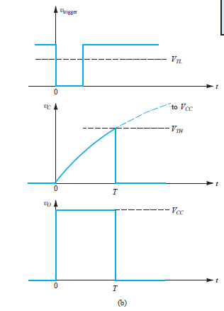
Monostable Operation
The output pulse width of time t, which is the time it takes to charge C to 2/3 of the supply voltage, is given by
t= 1.1RC

Slide 19
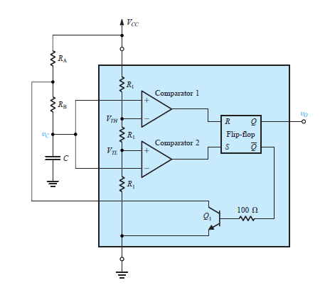
Astable Mode
The external capacitor charges through R_{A} + R_{B} and discharges through R_{B}.
The duty cycle may be precisely set by the ratio of these two resistors.

Slide 20
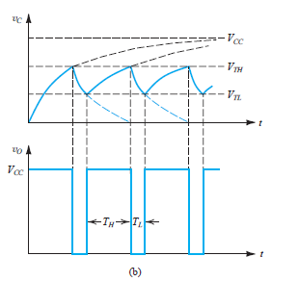
Astable Mode
In this mode of operation, the capacitor charges and discharges between 1/3 VCC and 2/3 VCC.
As in the triggered mode, the charge and discharge times, and therefore the frequency are independent on the supply voltage.

Slide 21
Project Information
The course project is open ended; this means that you have freedom in choosing your circuit, but it needs to have at least one 555timer.
It is preferred to use the timer in junction with a sensor. Simply oscillating circuits are basic and not considered design.
You cannot use digital components.
You can create your own digital gates from transistors.
This project must be conceived in terms of a "product'' that your team will design, with a set of overall objectives and especially with a set of minimum specifications which it must meet.

Slide 22
Project Information
Each team will then compete to design the best product (most elegant design, best performance, most closely meets specifications, most intuitively operated, lowest parts count and parts cost, etc.).
You may want to take the design in steps: First decide on a general project in terms of what you may want your circuit to do.
Perform a circuit analysis and confirm the result using LTspice. Your primary design should be submitted as your proposal by Mar. 28th. Your project needs approval before you can move on.
Provide enough information about your project; it will make the evaluation easier, and you get the approval faster. I will start by reading the reports that are clearer, and then get to the more unpleasant ones!
Your list of required parts should be included in the proposal.
Budget is limited to $10 ordering new parts that are not in your kit.

Slide 23
Toy Organ

Slide 24
Sample Projects
Motor PWM
Reaction Timer Game
4 Way Traffic Lights
Driving many LEDs
3x3x3 Cube
Bike Turning Signal
Police Lights
Roulette
Automatic Curtain Closer
Burglar Alarm 4-Zone
Clap on, clap off circuit

